Slide 1


GoTrash
Keynote Gotham-55 T-DIT-700

Slide 2
SUMMARY
1. Introduction
2. Team
3. Organization
4. Change
5. Feedback
6. Acquired skills
7. Questions

Slide 3


Introduction

Slide 4
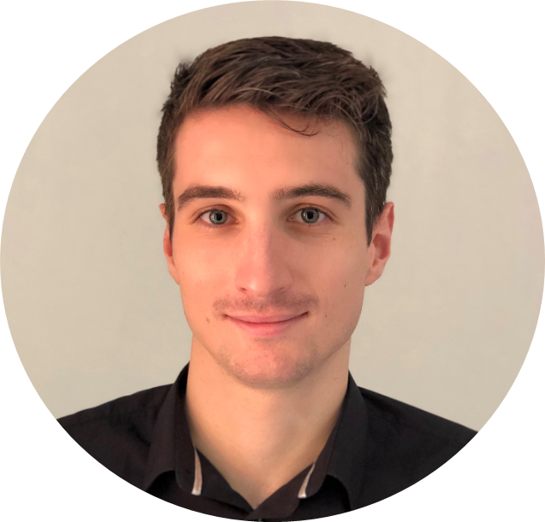
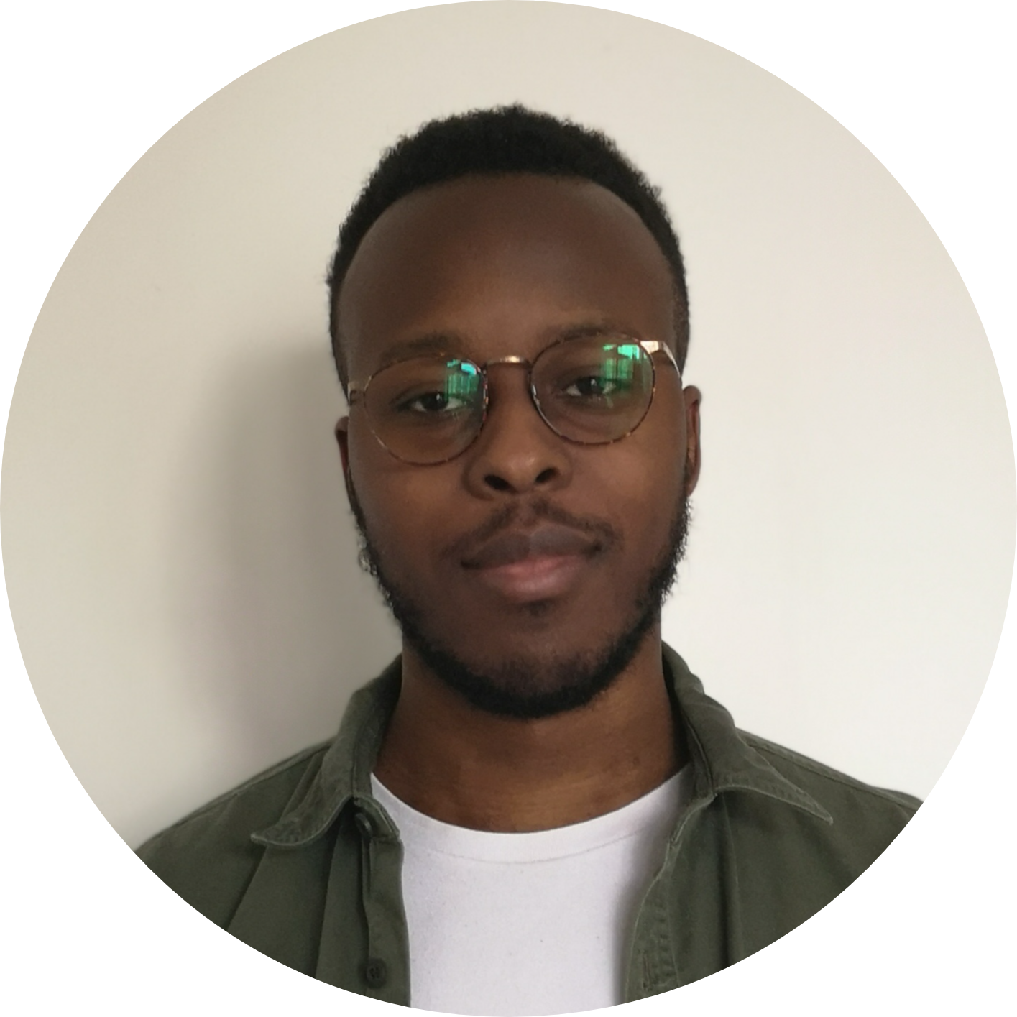
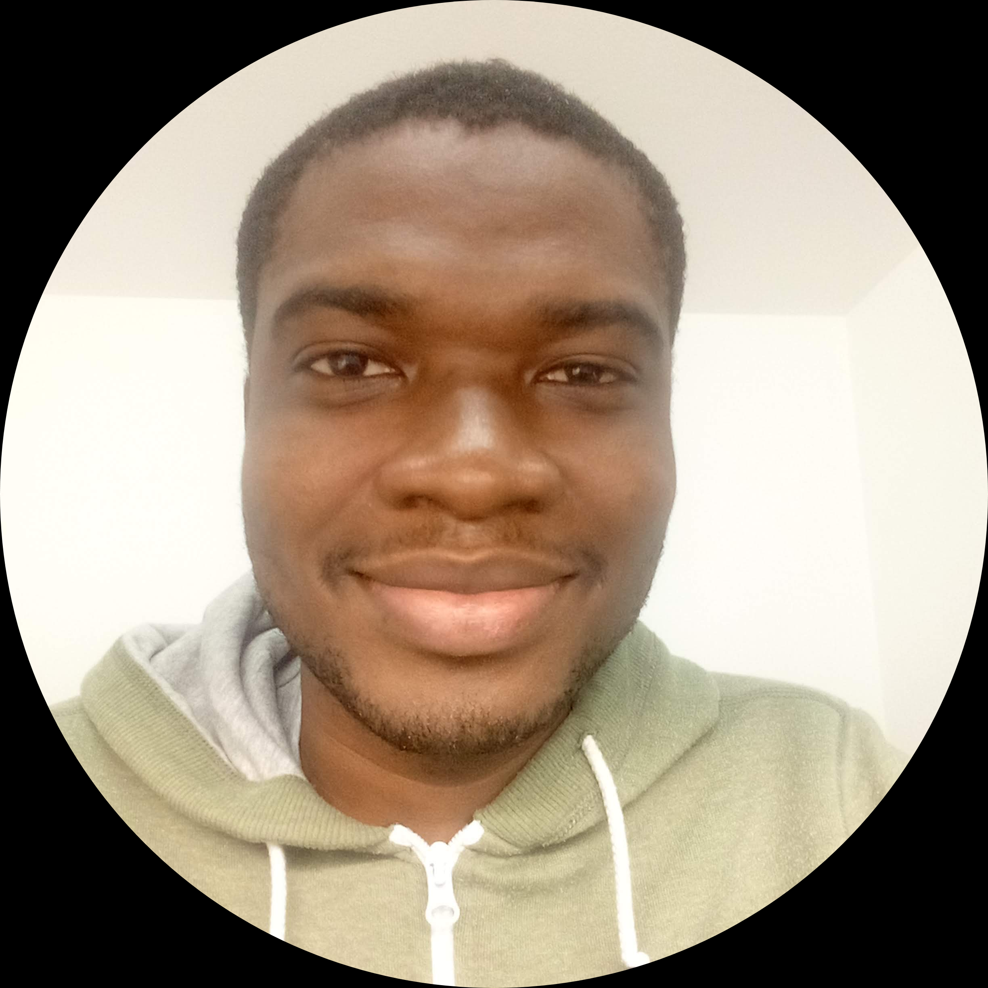
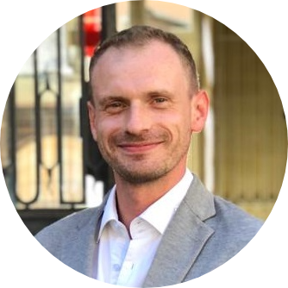
Team
Anthony Barnoin
Johan-David Dehi
Kotchenin Kosson Fanidjil Kassigni
Gregory Koenig

Slide 5




Organisation

Slide 6
Change (before)
Need
Identify
Design
Coach

Slide 7
Change (during)
Communicate
Train

Slide 8
Change (after)
Measure
Mitigate
Celebrate

Slide 9
FEEDBACK
Handling three simultaneous projects on a short deadline
Tackling a subject without prior knowledge of it
Remote work
Facing organization difficulties
Ability to solve any issue encountered

Slide 10
ACQUIRED SKILLS
Setting up a change
The role of communication in change management
Best practice to implement change
Learning to work with unknown students
Producing documentations

Slide 11

questions

Slide 12
Thank you all !

